Slide 1

The Best Business Model
Toh Zhi Yuan | Tan Cheng Kiat | Sean Ng | Darien Ang | Nazira
Notes:
Good morning everyone, we’re group 4 and we’ll be presenting project 3.
Since the COVID-19 pandemic in 2019, many news reports reveal that there has been a rapidly growing interest in pet ownership.
More people have expressed interest in adopting or fostering dogs and cats for various reasons - such as for companionship during circuit breaker or ease of caring for pets due to work-from-home arrangements.

Slide 2
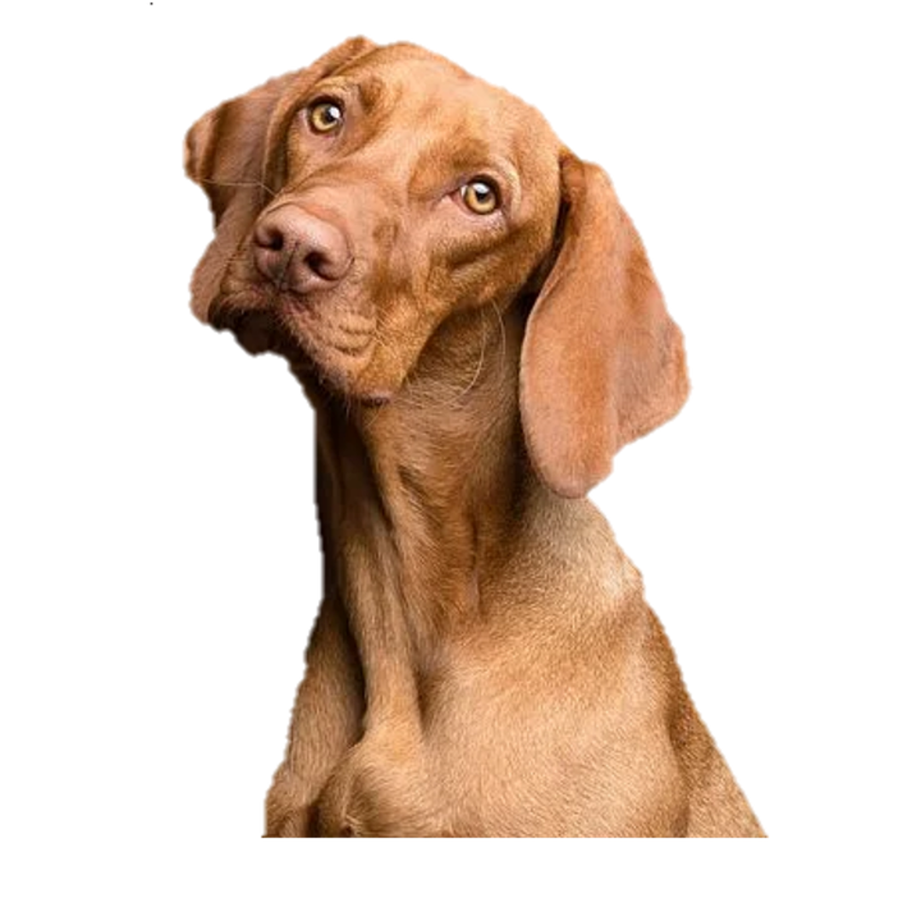
Problem Statement
We want to help you identify:
Topics of interests and needs of these new dog and cat owners
Suggest a viable business model for pet lovers
to venture into the pet industry
Provide relevant suggestions on creating
new services for dog and cat owners
Notes:
Introducing "CatDog" (which is the audience) - a “start-up” company in the Pet Industry. CatDog has outsourced us data scientists to Figure out the wants and needs of dog and cat owners by looking at relevant subreddits so that we can suggest a viable business model for pet lovers to venture into the pet industry. And also to provide relevant suggestions on creating new services for dog and cat owners.

Slide 3
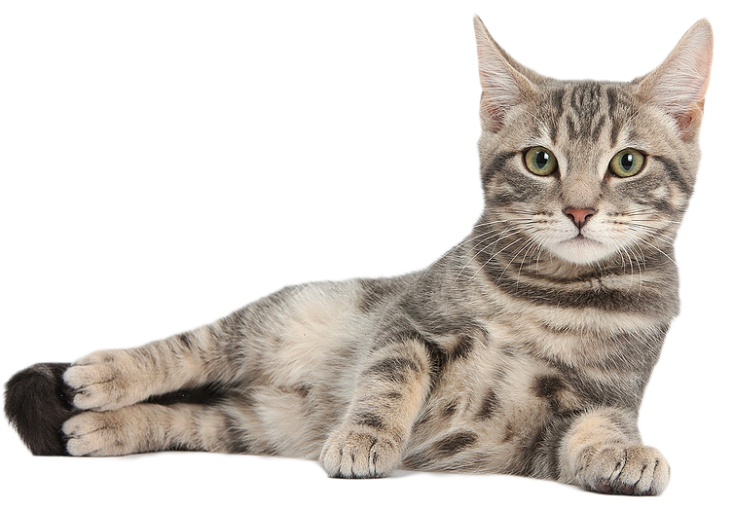
Problem Statement
Reddit is a massive collection of forums where people can share social news and content. Essentially, posts are organised according to subject into user-created ‘subreddits’.
Members submit content (such as images, texts, and links) to
subreddits, which can then be voted up (‘upvote’) or
down (‘downvote’) by other members.
Notes:
So we got our data from Reddit and Reddit is a massive collection of forums where people can share social news and content. Essentially, posts are categorised according to subjects which are then organised into user-created 'subreddits'. So Members submit content (such as images, texts, and links) to subreddits, which can then be voted up ('upvote') or down ('downvote') by other members.

Slide 4
Problem Statement
Our team aims to engineer selective supervised classification models namely:
Random Forest Classifier
Multinomial Naive Bayes
Logistics Regression Classifier
Notes:
Our team aims to engineer 3 supervised classification models , the first one is Random Forest Classifier, the second one is Multinomial Naive Bayes and the last one is Logistics Regression Classifier and then we select one model that best predicts the classification of the subreddit for current and future posts submitted by either dog or cat owners. So we select the best model based on the accuracy score (which tells us its predictive power) of both models on the test set, and look at the most important word features for that particular model to draw conclusions for CatDog. As you can already tell, the two subreddits that we will be using are Cats and Dogs
Sean: You want to remove that whole paragraph in the slides?

Slide 5
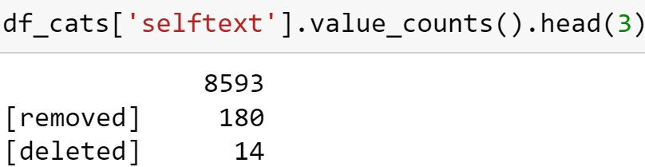
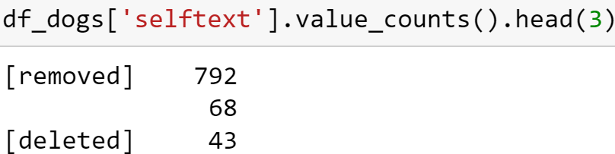
Data Collection
Scrap 20,000 posts (body text)
10,000 for each subreddit
2) Preliminary Analysis
Selftext from Cats: 8593 of which Blanks (85% of Data)
3) Reason for Blanks???
Cat owners like to post pictures only!
Notes:
Why did we choose r/cats and r/dogs
5 clearly differentiated topics for cats and dog lovers
Data Collection
Was enough data gathered to generate a significant result?
Was data collected that was useful and relevant to the project?
Was data collection and storage optimized through custom functions, pipelines, and/or automation?
Was thought given to the server receiving the requests such as considering number of requests per second?

Slide 6

SOLUTION
Use Post Title instead
Notes:
Why did we choose r/cats and r/dogs
5 clearly differentiated topics for cats and dog lovers
Data Collection
Was enough data gathered to generate a significant result?
Was data collected that was useful and relevant to the project?
Was data collection and storage optimized through custom functions, pipelines, and/or automation?
Was thought given to the server receiving the requests such as considering number of requests per second?

Slide 7

Data Collection - Time Taken
Time to scrap 10,000 posts/subreddit?
Cats
Total: 10.7 min
Mean: 6.5s
Dogs
Total: 9.1 min
Mean: 5.5s
2) Why scraping posts r/cats take longer???
Emojis!!! Cat owners/lovers just them.
Notes:
Why did we choose r/cats and r/dogs
5 clearly differentiated topics for cats and dog lovers
Data Collection
Was enough data gathered to generate a significant result?
Was data collected that was useful and relevant to the project?
Was data collection and storage optimized through custom functions, pipelines, and/or automation?
Was thought given to the server receiving the requests such as considering number of requests per second?

Slide 8
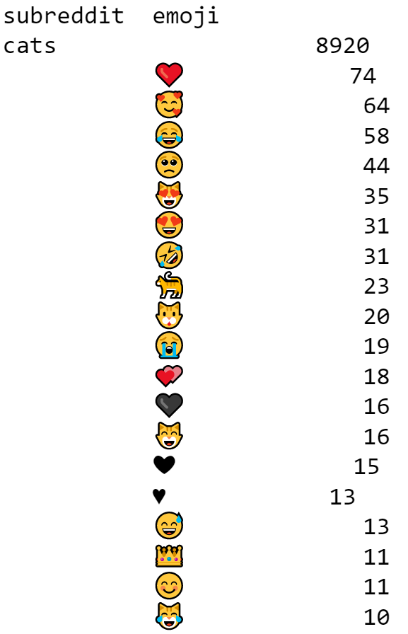
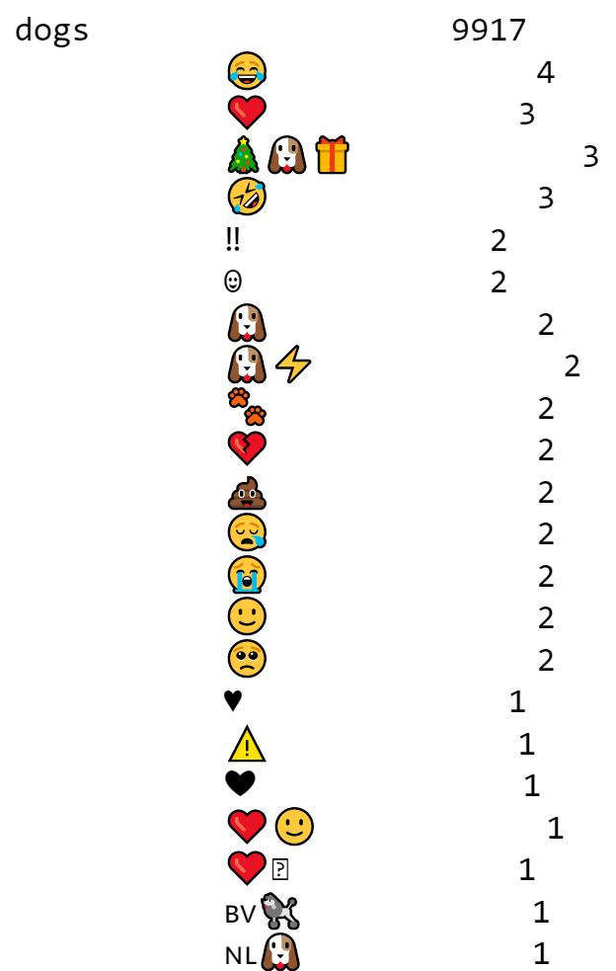
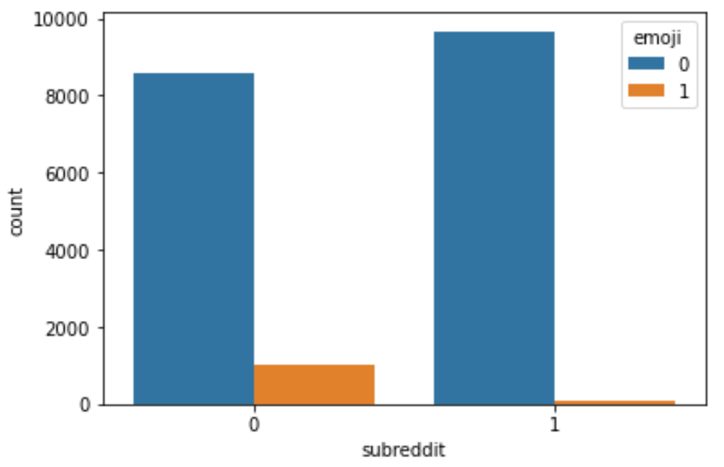
Cleaning Emoji
Extracting Emoji to a new column
Emoji
Cats: 1072
Dogs: 79
Insightful Feature Created
Notes:
Data Cleaning and EDA
Are missing values imputed/handled appropriately?
Are distributions examined and described?
Are outliers identified and addressed?
Are appropriate summary statistics provided?
Are steps taken during data cleaning and EDA framed appropriately?
Does the student address whether or not they are likely to be able to answer their problem statement with the provided data given what they've discovered during EDA?

Slide 9
Cleaning the Rest
Lower Case
Remove Punctuations
Remove Foreign Languages
Remove Hyperlinks
Remove Numbers

Slide 10
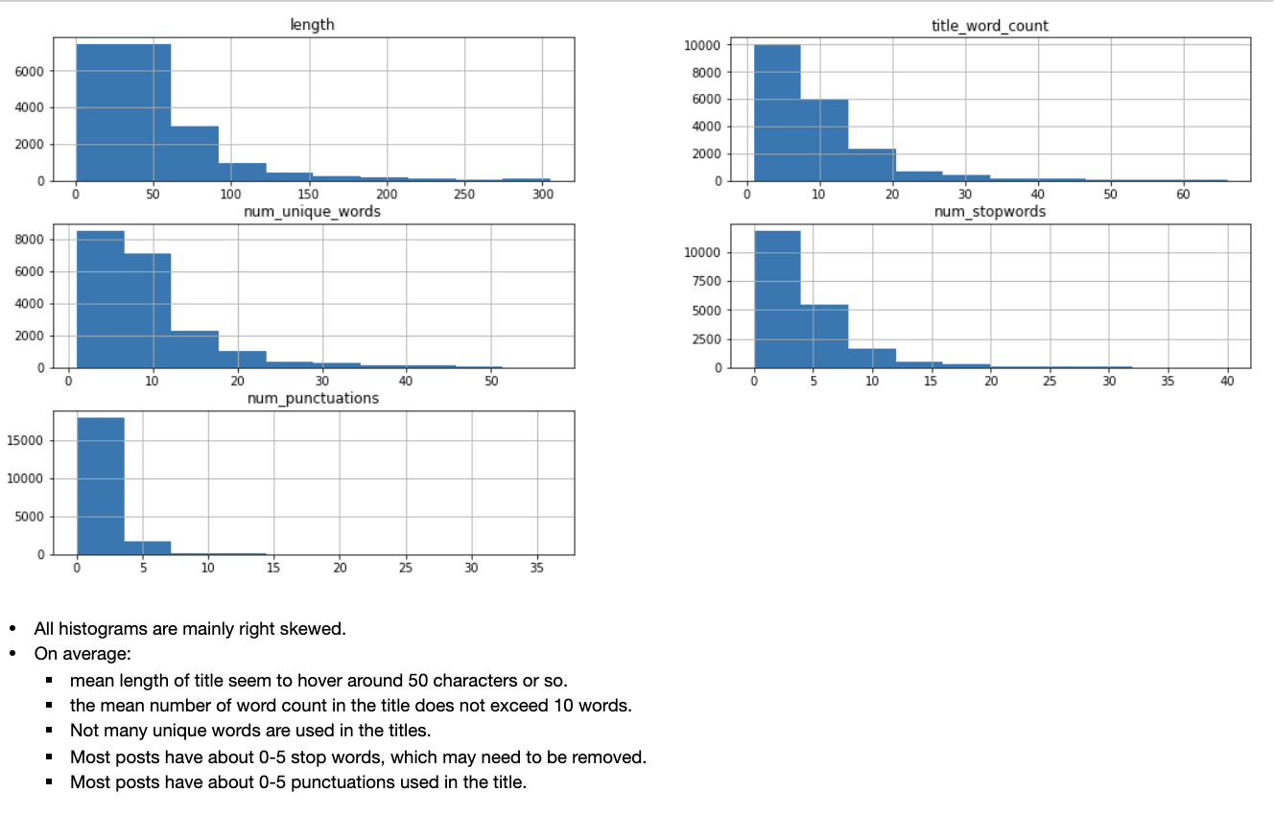
EDA
Features engineered:
Length (i.e. no. of characters)
Word count of Title
No. of Unique Words
No. of Stopwords
No. of Punctuation
\
Notes:
We did brief feature engineering to explore the general data a bit, and derived five features - such as word count of title, no of stopwords and no of unique words. We ran a histogram on these features to explore the distribution of data. As you can see, all the histograms are right skewed.
- On average for both subreddits:
- mean length of title seem to hover around 50 characters or so - the mean number of word count in the title does not exceed 10 words. - Not many unique words are used in the titles. - Most posts have about 0-5 stop words, which may need to be removed.- Most posts have about 0-5 punctuations used in the title as well

Slide 11
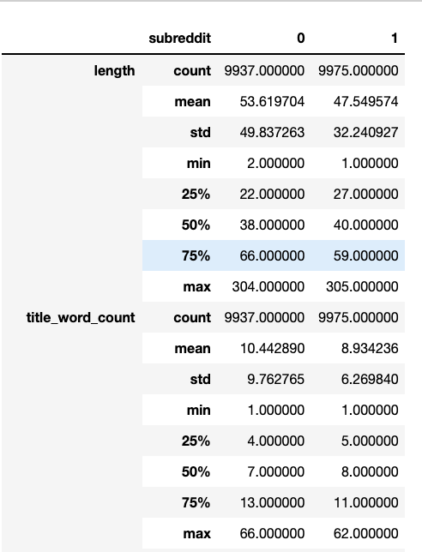
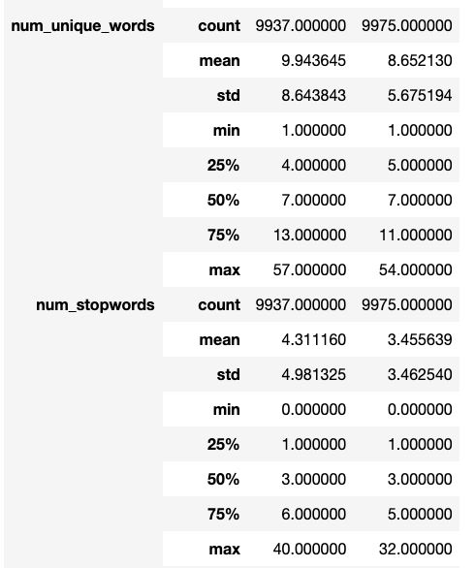
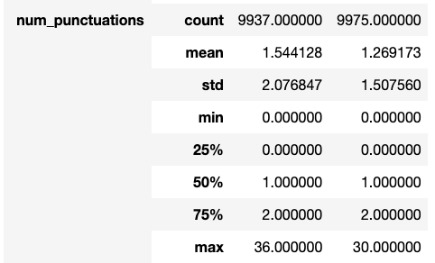
EDA
Notes:
We also applied a describe function to analyze the various features according to subreddit. Subreddit 0 is cats, while 1 is dogs. We look into the next slide for a condense version.

Slide 12
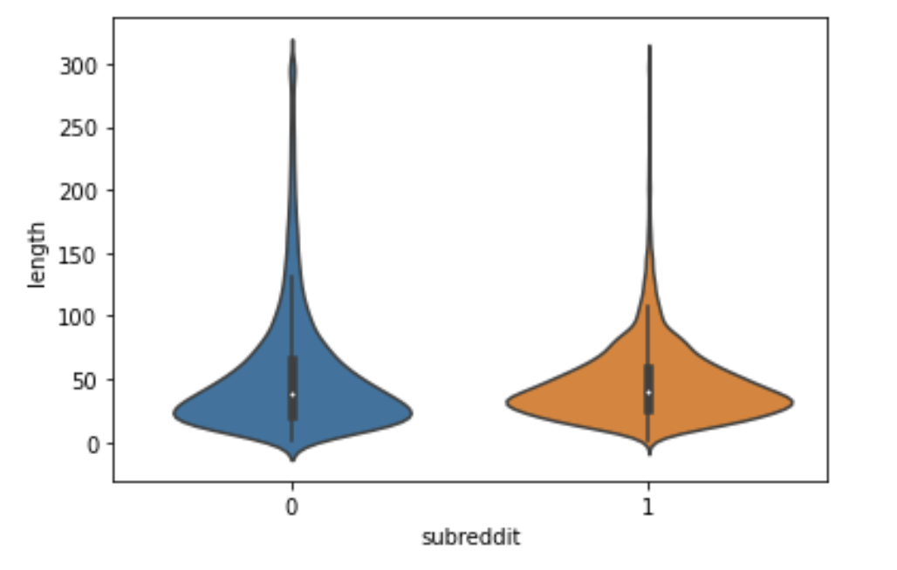
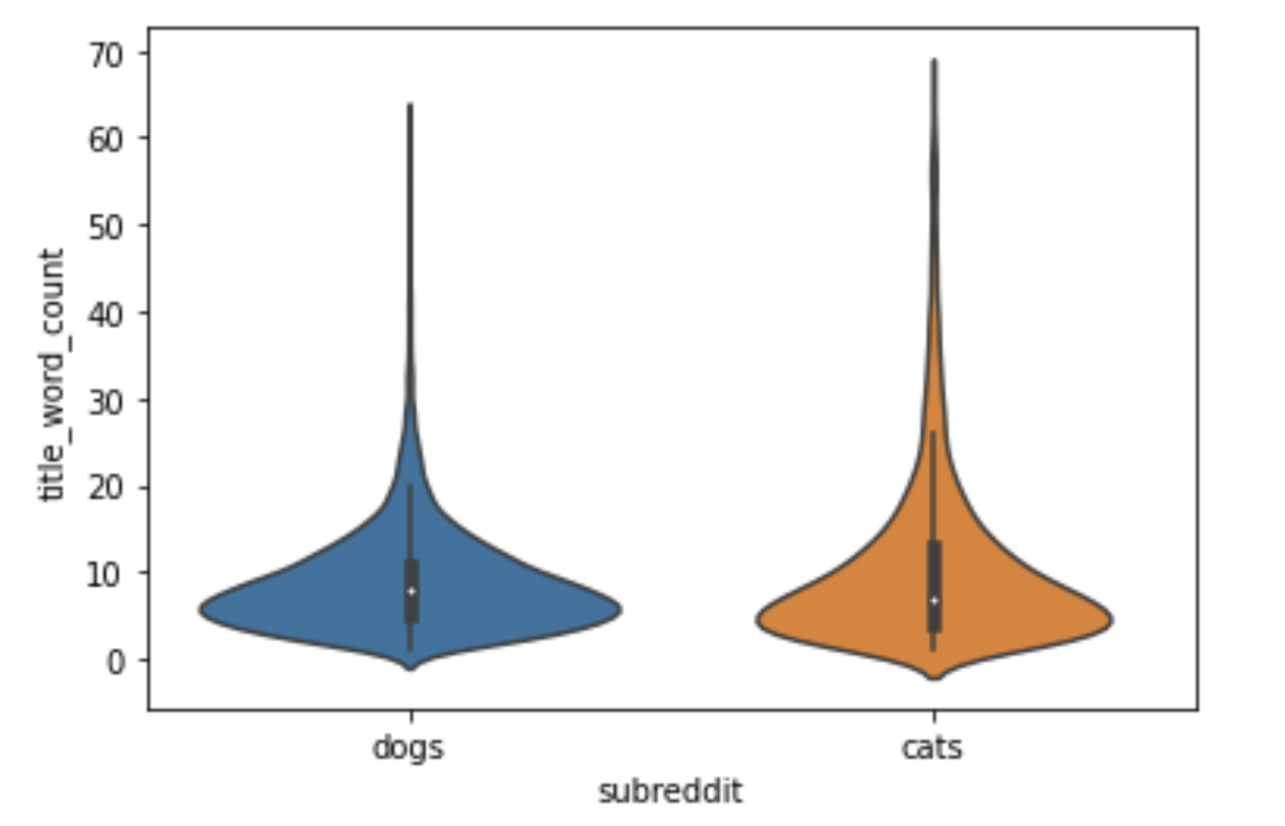
EDA
Notes:
We also generated violinplot using seaborn library to understand the distribution of data between subreddits.
We discover that the subreddit cats have more outliers in their titles than subreddit dogs, as shown in the violinplots. This is true for most of the violinplots.

Slide 13
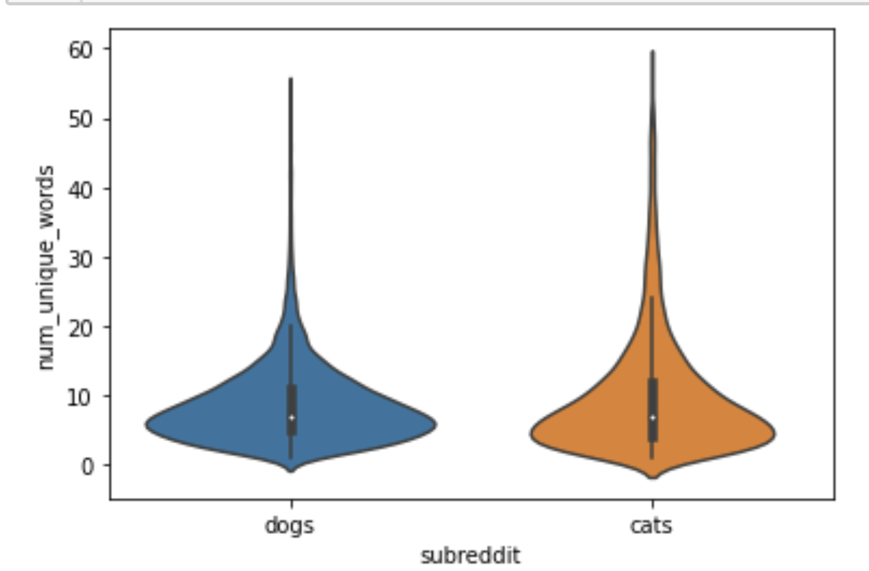
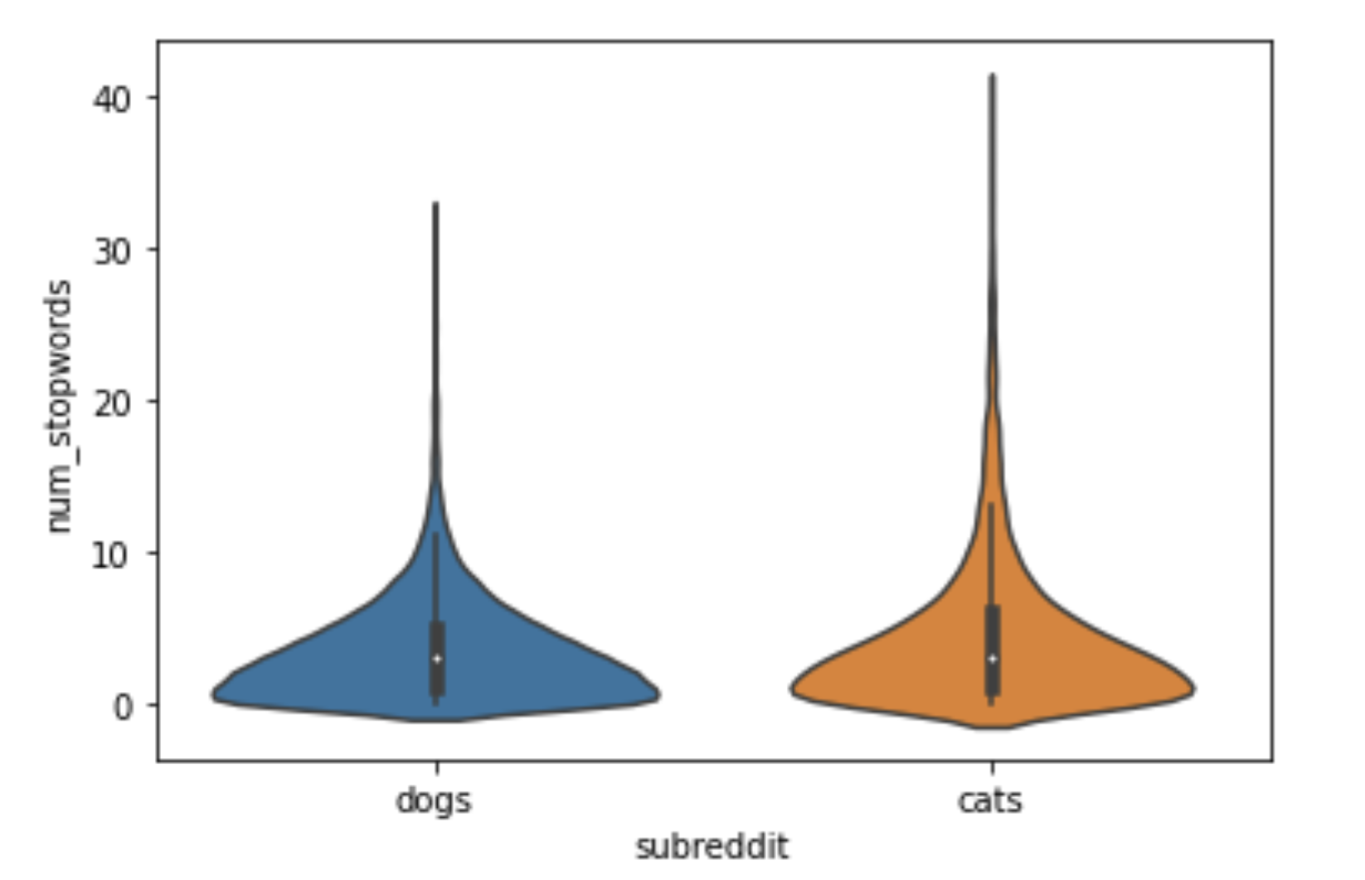
EDA

Slide 14
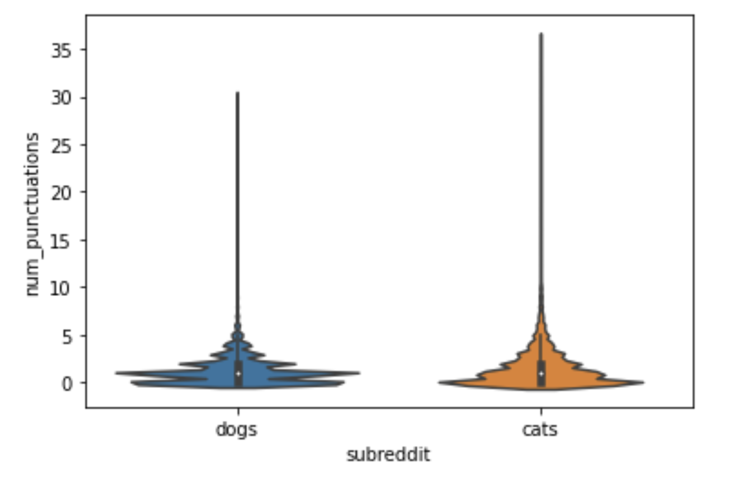
EDA
Notes:
FOr the punctuations, there seem to be various extreme peaks in the number of punctuations in subreddit dogs compared to cats. Otherwise, cats having outliers remain. ß

Slide 15
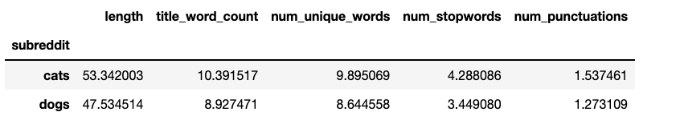

EDA
Notes:
We also applied a describe function to analyze the various features according to subreddit.
- Redditors in subreddit "Cats" tend to post slightly longer titles, with more word count, unique words and stopwords. Maybe cat owners/redditors here are more passionate? May explain why scrapping cats take longer.

Slide 16
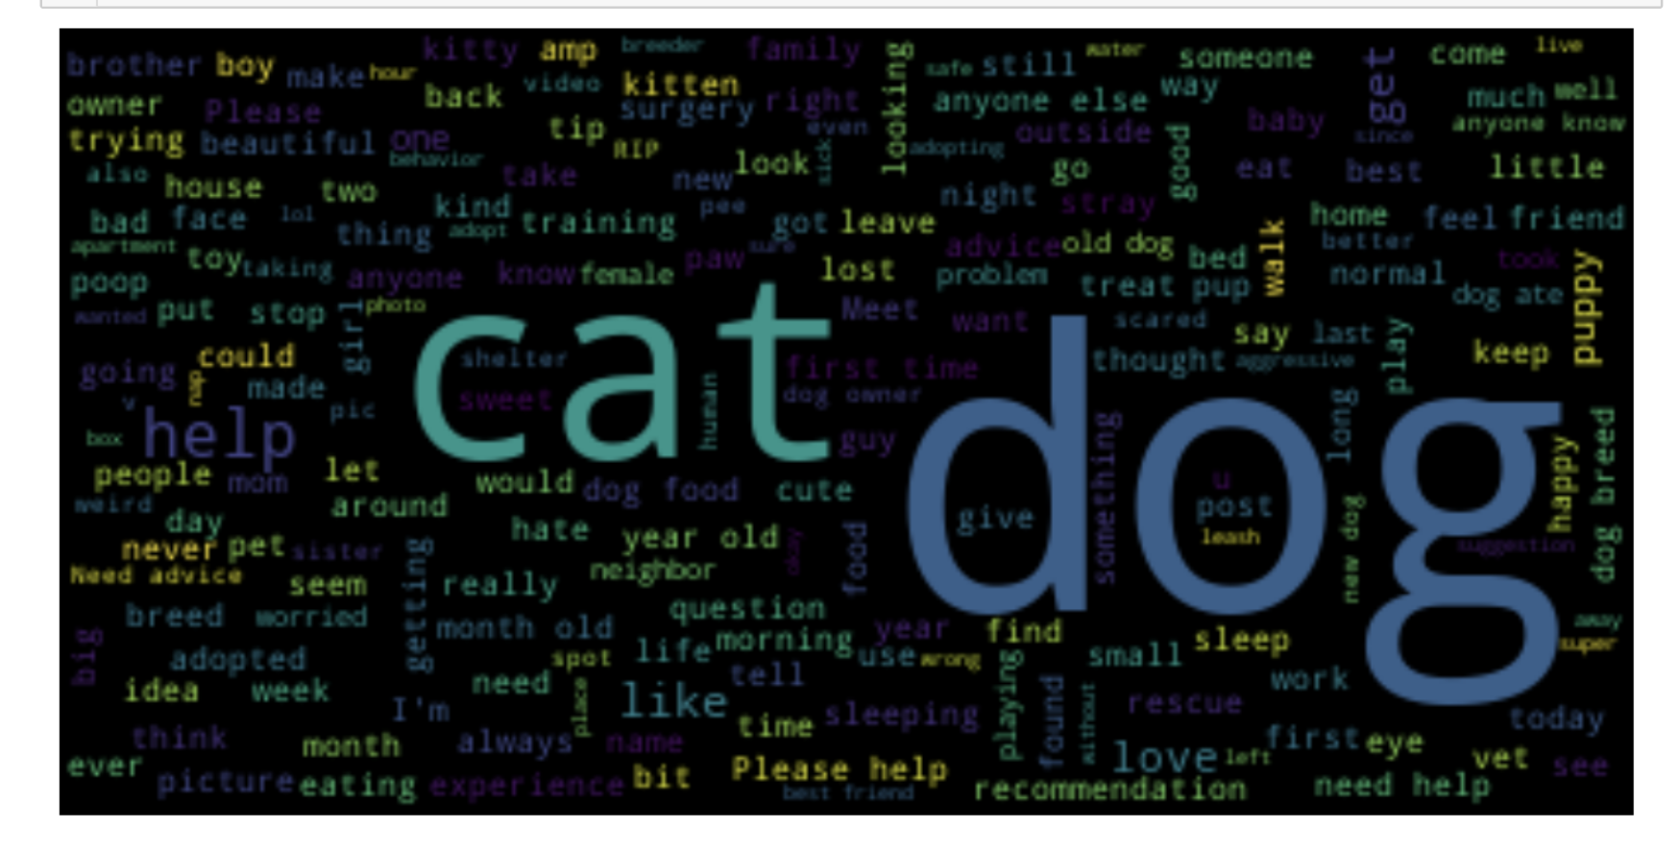
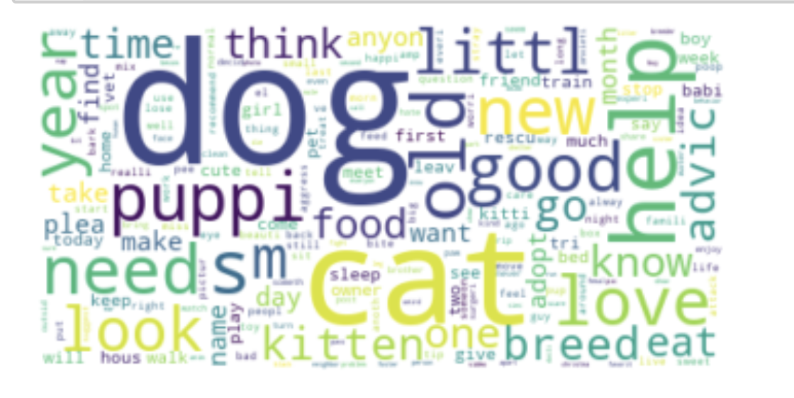


EDA
Word Cloud before clean up
Word Cloud after clean up
Notes:
Using the wordcloud generator, we present brief wordclouds we conducted for our dataframe before and after we cleaned. the words cat and dog seem to make up the most numbers in the titles.
In the word clouds before cleaning up, words like "help', 'advice', 'recommendation', ' question', ' old dog', 'dog breed' all stand out at first glance. This may seem to indicate that redditors are looking for some form of help on these subreddits cats and dogs, although we are unsure if its one specific reddit that these words refer to.
In the word clouds after cleaning, stop words have been removed. Some words, including 'help', 'love', 'need', 'look', 'year', 'new' and ‘breed’ have become more prominent. This gives us a preliminary indication as to what kind of needs cat and dog owners may need so that we can inform catdog on business ideas.

Slide 17
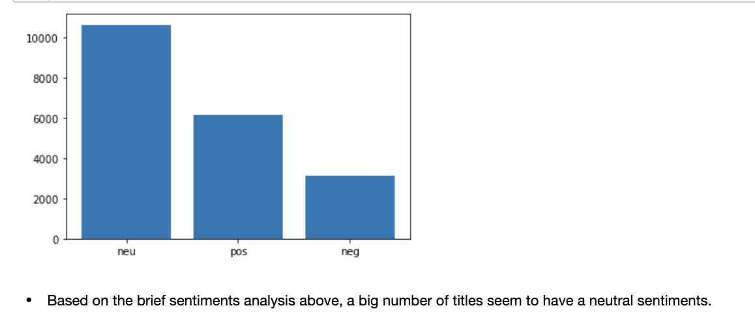
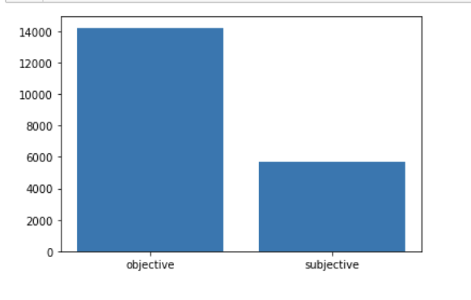


EDA
Notes:
We also did a brief sentiment/subjectivity analysis using the Textblob library.
Based on the brief sentiments analysis above, a big number of titles seem to have a neutral sentiment. Based on the brief subjectivity score, there seems to be more factual titles?

Slide 18

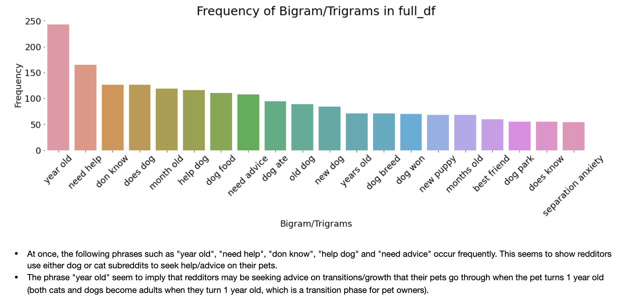
EDA
Notes:
We used a countvectorizer to generate the bigrams for the uncleaned title. At once, the following phrases such as "year old", "need help", "don know", "help dog" and "need advice" occur frequently. This seems to show redditors use either dog or cat subreddits to seek help/advice on their pets. Most words seem to belong to the subreddit dog.
The phrase "year old" seem to imply that redditors may be seeking advice on transitions/growth that their pets go through when the pet turns 1 year old (both cats and dogs become adults when they turn 1 year old, which is a transition phase for pet owners). This may indicate some kind of service gap for pet owners whose pet turn into adults.

Slide 19

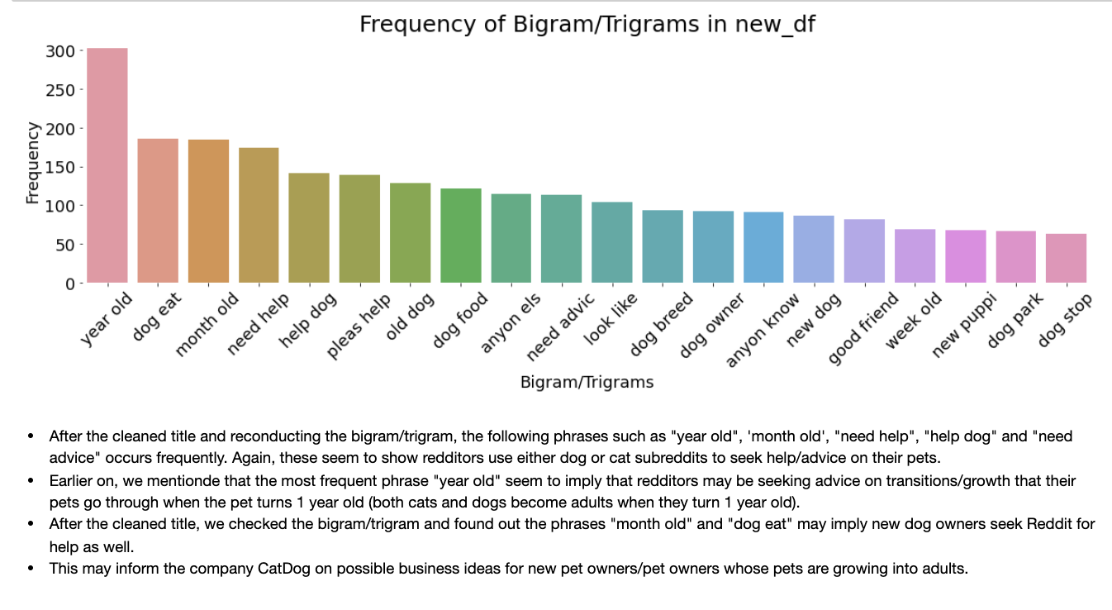
EDA
Notes:
After the cleaned title and reconducting the bigram/trigram, We used a countvectorizer to generate the bigrams frequency. the following phrases such as "year old", 'month old', "need help", "help dog" and "need advice" occurs frequently. These seem to show redditors, possibly new dog/cat owners, use either dog or cat subreddits to seek help/advice on their pets. Most words seem to belong to the subreddit dog.
The phrase "year old" occurs frequently. THis seem to imply that redditors may be seeking advice on transitions/growth that their pets go through when the pet turns 1 year old (both cats and dogs become adults when they turn 1 year old, which is a transition phase for pet owners). This may indicate some kind of service gap for pet owners whose pet turn into adults.

Slide 20

Pre-processing
CountVectorizer ( stop_words = ‘english’)
Total columns = 13,472
Increase stopwords
Stemming or Lemmatization
Notes:
Preprocessing and Modeling
Is text data successfully converted to a matrix representation?
Are methods such as stop words, stemming, and lemmatization explored?
Does the student properly split and/or sample the data for validation/training purposes?
Does the student test and evaluate a variety of models to identify a production algorithm (AT MINIMUM: Random Forest and one other model)?
Does the student defend their choice of production model relevant to the data at hand and the problem?
Does the student explain how the model works and evaluate its performance successes/downfalls?

Slide 21
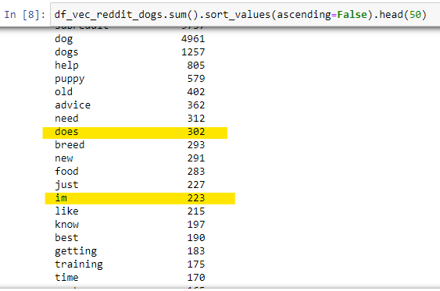
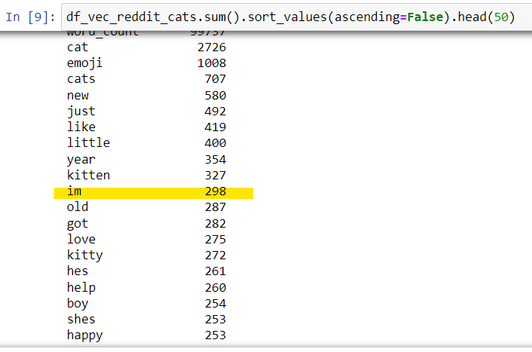
Pre-processing
Increase Stopwords (e.g. does and im)
Stemming (reduce 3294 words)
Lemmatize (reduce 1276 words)
Notes:
Preprocessing and Modeling
Is text data successfully converted to a matrix representation?
Are methods such as stop words, stemming, and lemmatization explored?
Does the student properly split and/or sample the data for validation/training purposes?
Does the student test and evaluate a variety of models to identify a production algorithm (AT MINIMUM: Random Forest and one other model)?
Does the student defend their choice of production model relevant to the data at hand and the problem?
Does the student explain how the model works and evaluate its performance successes/downfalls?

Slide 22
Modelling
Model (w cvec) | Train Accuracy | Test Accuracy
Baseline | 0.5039 | 0.5039
Random Forest | 0.9964 | 0.9115
Multinomial Naive Bayes | 0.9526 | 0.9192
Logistic Regression | 0.9617 | 0.9197
All models outperformed Baseline accuracy
Notes:
Preprocessing and Modeling
Is text data successfully converted to a matrix representation?
Are methods such as stop words, stemming, and lemmatization explored?
Does the student properly split and/or sample the data for validation/training purposes?
Does the student test and evaluate a variety of models to identify a production algorithm (AT MINIMUM: Random Forest and one other model)?
Does the student defend their choice of production model relevant to the data at hand and the problem?
Does the student explain how the model works and evaluate its performance successes/downfalls?

Slide 23
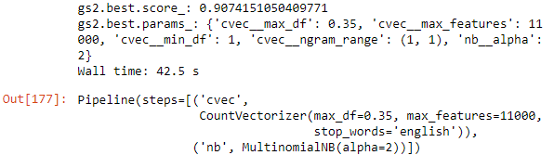
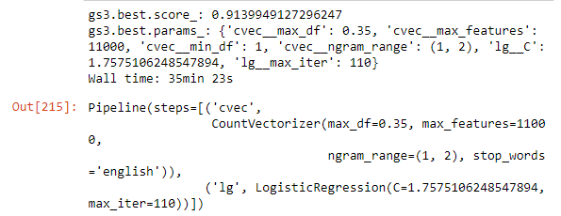
Modelling
MultinomialNB
Logistic Regression
Model (w cvec) | Train Accuracy | Test Accuracy
Multinomial Naive Bayes (GridSearch CV) | 0.9486 | 0.9194
Logistic Regression (GridSearch CV) | 0.9725 | 0.9199
Logistic regression is easier to implement, interpret and very efficient to train.
Notes:
Preprocessing and Modeling
Is text data successfully converted to a matrix representation?
Are methods such as stop words, stemming, and lemmatization explored?
Does the student properly split and/or sample the data for validation/training purposes?
Does the student test and evaluate a variety of models to identify a production algorithm (AT MINIMUM: Random Forest and one other model)?
Does the student defend their choice of production model relevant to the data at hand and the problem?
Does the student explain how the model works and evaluate its performance successes/downfalls?

Slide 24
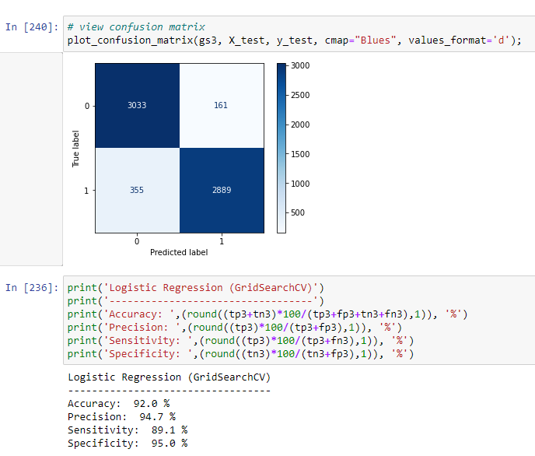
Modelling #2
Notes:
Preprocessing and Modeling
Is text data successfully converted to a matrix representation?
Are methods such as stop words, stemming, and lemmatization explored?
Does the student properly split and/or sample the data for validation/training purposes?
Does the student test and evaluate a variety of models to identify a production algorithm (AT MINIMUM: Random Forest and one other model)?
Does the student defend their choice of production model relevant to the data at hand and the problem?
Does the student explain how the model works and evaluate its performance successes/downfalls?

Slide 25
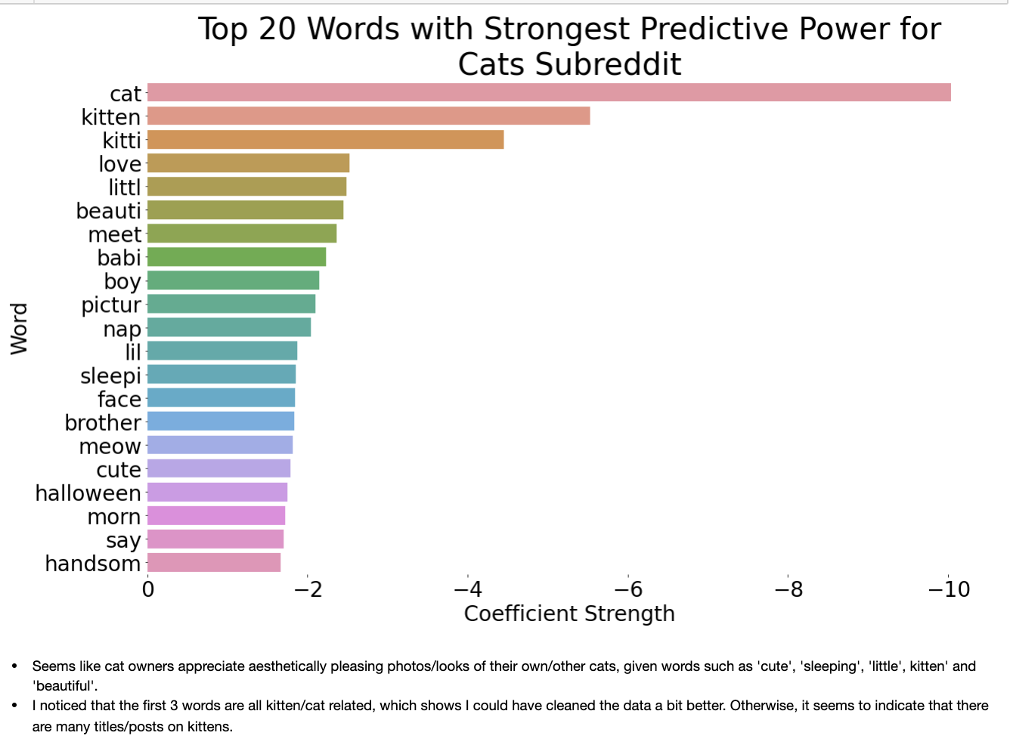
Recommendations: Top Words in r/cats
Words such as ‘cute’, ‘sleeping’, ‘little’, ‘kitten’ and ‘beautiful’ reappear more often
The r/cats subreddit community may appreciate the aesthetics of cats
More sharing of digital media
Notes:
We can observe that the top words that appear in the cat subreddits are ‘cute’, ‘sleeping’, ‘little’, ‘kitten’ and ‘beautiful’ reappear more often. This sort of goes to show that the community in r/cats may appreciate the aesthetics of cats more. Also, as mentioned by Cheng Kiat, the r/cats community like to post more photos and input more emoji.

Slide 26
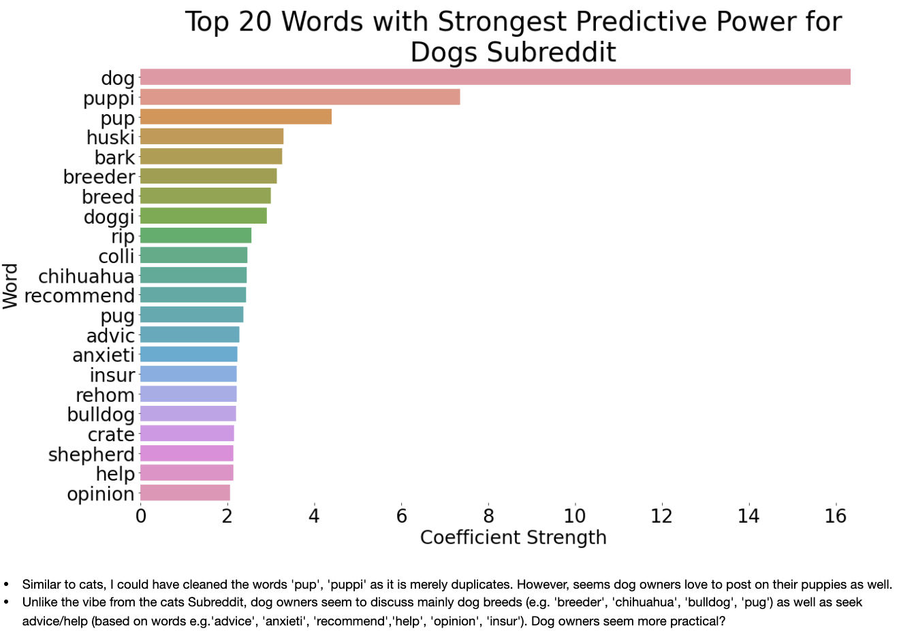
Recommendations: Top Words in r/dogs
Words stemming from dog breeds, ‘advic’ (advice), ‘anxieti’ (anxiety), ‘help’ and ‘opinion’ appear more frequently
The r/dogs subreddit community are more specific in asking for advice/help/opinions
Topics may seem more targeted towards dog breeds
Notes:
On the other hand, r/dogs seem to take a more factual, objective angle, as mentioned by Sean when a brief sentiment/subjectivity analysis was conducted using the Textblob library. The r/dogs community is more specific in asking for advice, help or opinions, and dog breeds seem to be a very important topic in the subreddit.

Slide 27
Recommendations
r/dogs - more practical and ‘discussion’ driven
Create consultancy and onboarding services for new dog owners
If interested to bring in breeds, the top words can signify the popular ones among dog lovers
r/cats - sharing of digital media
Grooming services or venture into F&B (e.g. cat café)
Usage of Words for Impactful Marketing
Unique words for r/dogs < 8 and r/cats < 5
Notes:
Therefore, we have some recommendations for CatDog to initiate for their possible business model. Starting with the r/dogs subreddit, CatDog may consider to create consultancy and onboarding services for new dog owners. They may bridge the gap in the adoption scene, where they can work together with non-profit organisations such as SPCA to improve the understanding of owning pet dogs. Not a fan of dogs? CatDog may also consider tapping on the quirks of the r/cats community - they can consider setting up grooming services or venture into F&B (like a cat café).
We also have a suggestion in terms of marketing. As we analyse the distribution of title lengths and unique words, it is also important to match the marketing style to the subreddit posts. When it comes to marketing material, we advise CatDog to utilise less than 8 unique words for dog publicity and less than 5 for cat publicity. Photos are

Slide 28
Improvements
Include dog, cat, and the variations related to these two words e.g. puppy, kitten in the stopword removal process.
Having posts with more unique words helps to distinguish between spam and ham but;
Not all posts with unique words are relevant, so we have to focus more on the coefficient of frequently appearing words
Explore other forums that are more local e.g. Hardwarezone because Reddit posts are more global and may not attune well to local context

